Slide 1

Lil Luna
Nathan Jones, Abrar Faiyaz, Valentine Mohaugen, Landon Holcomb, Jack Layton

Slide 2
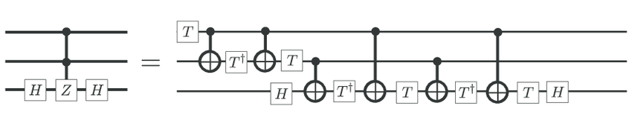

The Challenge
Tasks:
  Compile 11 target unitaries into Clifford+T circuits
  Maximize "Clifford Absorption"
  Minimize T-count
  Minimize the Operator Norm Distance
Constraints:
  Use {H, T, Tdg, S, Sdg, CNOT} gates
  Ancilla-free circuits

Slide 3
Our Approach
Step 1: Identify structure:
Clifford? diagonal? Pauli exponential? Controlled rotation? Random?
Step 2: Decide synthesis route:
Exact Clifford
Exact Clifford+T
Approximate synthesis (Ross–Selinger via newsynth/gridsynth)
Post-optimization (Amy–Mosca phase polynomial via rmsynth)
challenge (2)
Step 3: Explore T-count vs accuracy tradeoff
select “low-T” submission vs “low-distance” submission depending on scoreboard needs

Slide 4


Structured Problems
Type A: Exact / identity-based
These are the “free wins”:
  some are pure Clifford
  others are exact Clifford+T
Usually: structured matrices, controlled gates, or Hamiltonians that simplify.
Goal: distance = 0 with as few gates as possible.
Type B: “Rotation-driven” problems
These are the ones where the unitary is mostly easy, except for one thing:
  an angle like 𝜋/7 that can’t be expressed cheaply using Clifford alone.
Common patterns from the sheet:
  controlled 𝑅_{Y}(𝜋/7) (problem #2)
  challenge
  exponentials like exp(𝑖𝜋/7(𝑍⊗𝑍)) (#3)
  challenge
  Ising / simulation Hamiltonians (#6)
  challenge
Strategy:
  convert most of the unitary into Clifford gadgets
  isolate the remaining part into a small number of Z-rotations
  synthesize those using Ross–Selinger / newsynth (near-optimal Clifford+T approximation).

Slide 5
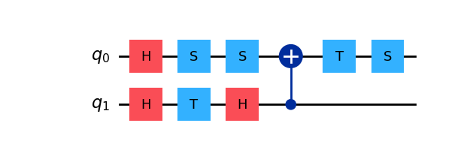
Unstructured Problems
Type C: “No obvious structure” problems
Examples:
  random unitary (#10)
  challenge
  state preparation (#7)
  challenge
In these, there isn’t a nice symbolic simplification.
So we go computational:
  synthesize candidates at multiple tolerances
  greedy optimization loop with
    rmsynth
    identity search
    commutative aggregation
    qiskit-transpile
Bonus: Breadth First Search
  State preparation: smaller dimension
  Computationally feasible to simply search
    Circuit depth < 11
    T-count < 3
  Result: T-Count 2 circuit with 0.979 fidelity

Slide 6

`synth` Packages
`rmsynth`
  For phase polynomial optimization
  Amy & Mosca
`gridsynth`
  For optimal R_z approximation
  Ross & Selinger
`qiskit`
  For intermediate representation and fidelity checks

Slide 7
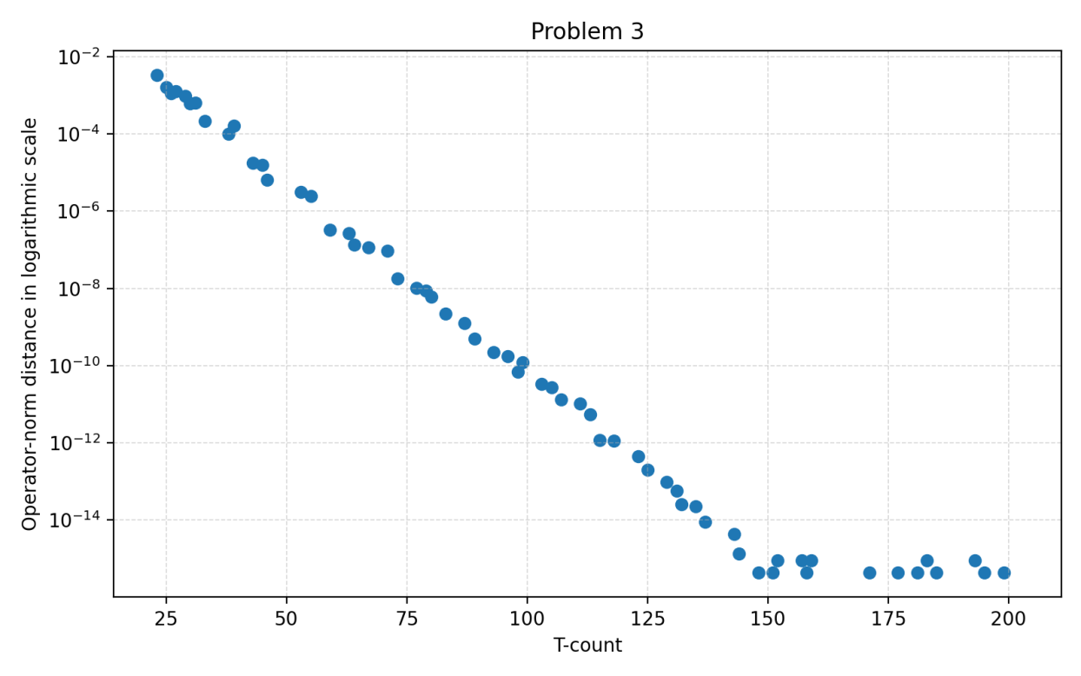
Data

Slide 8
Bonus Problem
Because the Pauli terms commute pairwise, this was not a Trotterization problem
We were able to solve exactly for the zero operator norm distance and achieved a fidelity of 1.0

Slide 9
Data - Top of the Leaderboard!
Problem | 1 | 2 | 3 | 4 | 5 | 6 | 7* | 8 | 9 | 10 | 11 | 12
Best Norm | 0 | 4e-14 | 2e-14 | 4e-14 | 2e-16 | 1e-12 | 1.0 | 3e-16 | 1e-16 | 1e-10 | 3e-16 | 2e-13
Best Norm T-Count | 0 | 284 | 144 | 286 | 0 | 748 | 594 | 3 | 3 | 1525 | 4 | 1963
Best T-Count Norm | - | 0.22 | 0.05 | 0.11 | - | 0.44 | 0.979 | - | - | 1e-5 | - | -
Best T-Count | - | 0 | 1 | 2 | - | 2 | 2 | - | - | 1044 | - | -
*Fidelity rather than norm

